Slide 1

Tower Defense Game
Git-Squad
Ricardo Almeida
Ryan Sharp

Slide 2
Overview
Main
Game UI
Game States
Input Handling
Player
Levels
Entities
Enemies
Towers

Slide 3
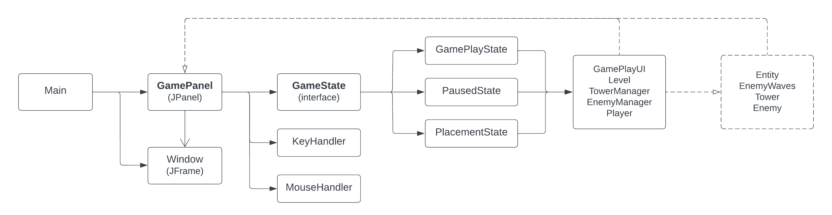
Overview Main

Slide 4
What is this game?
Levels have pre-defined paths
Enemies spawn at one end and move to the other
Player loses life if enemies reach the end
Towers are placed to destroy the enemies
Players gain gold for damaging enemies
Waves of enemies are harder over time

Slide 5
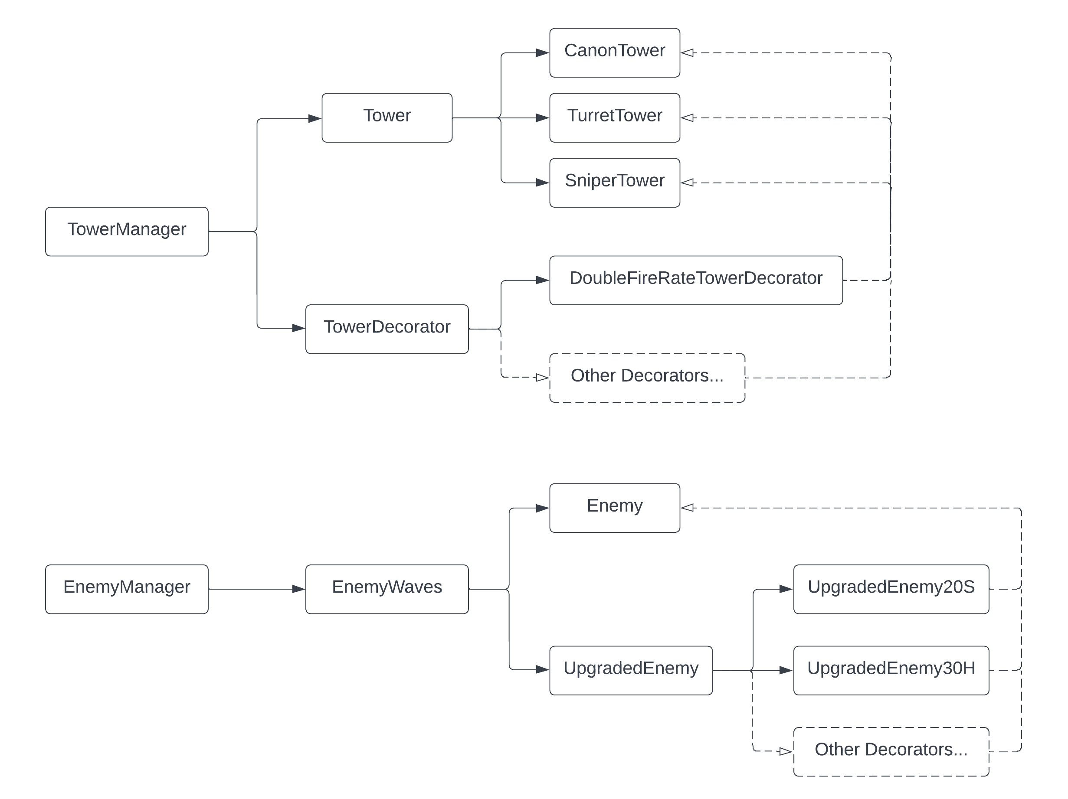
Overview Enemies and Towers

Slide 6
Main Package
Responsibilities:
Game States
Input Handling
Player
Patterns
Singleton
Strategy

Slide 7
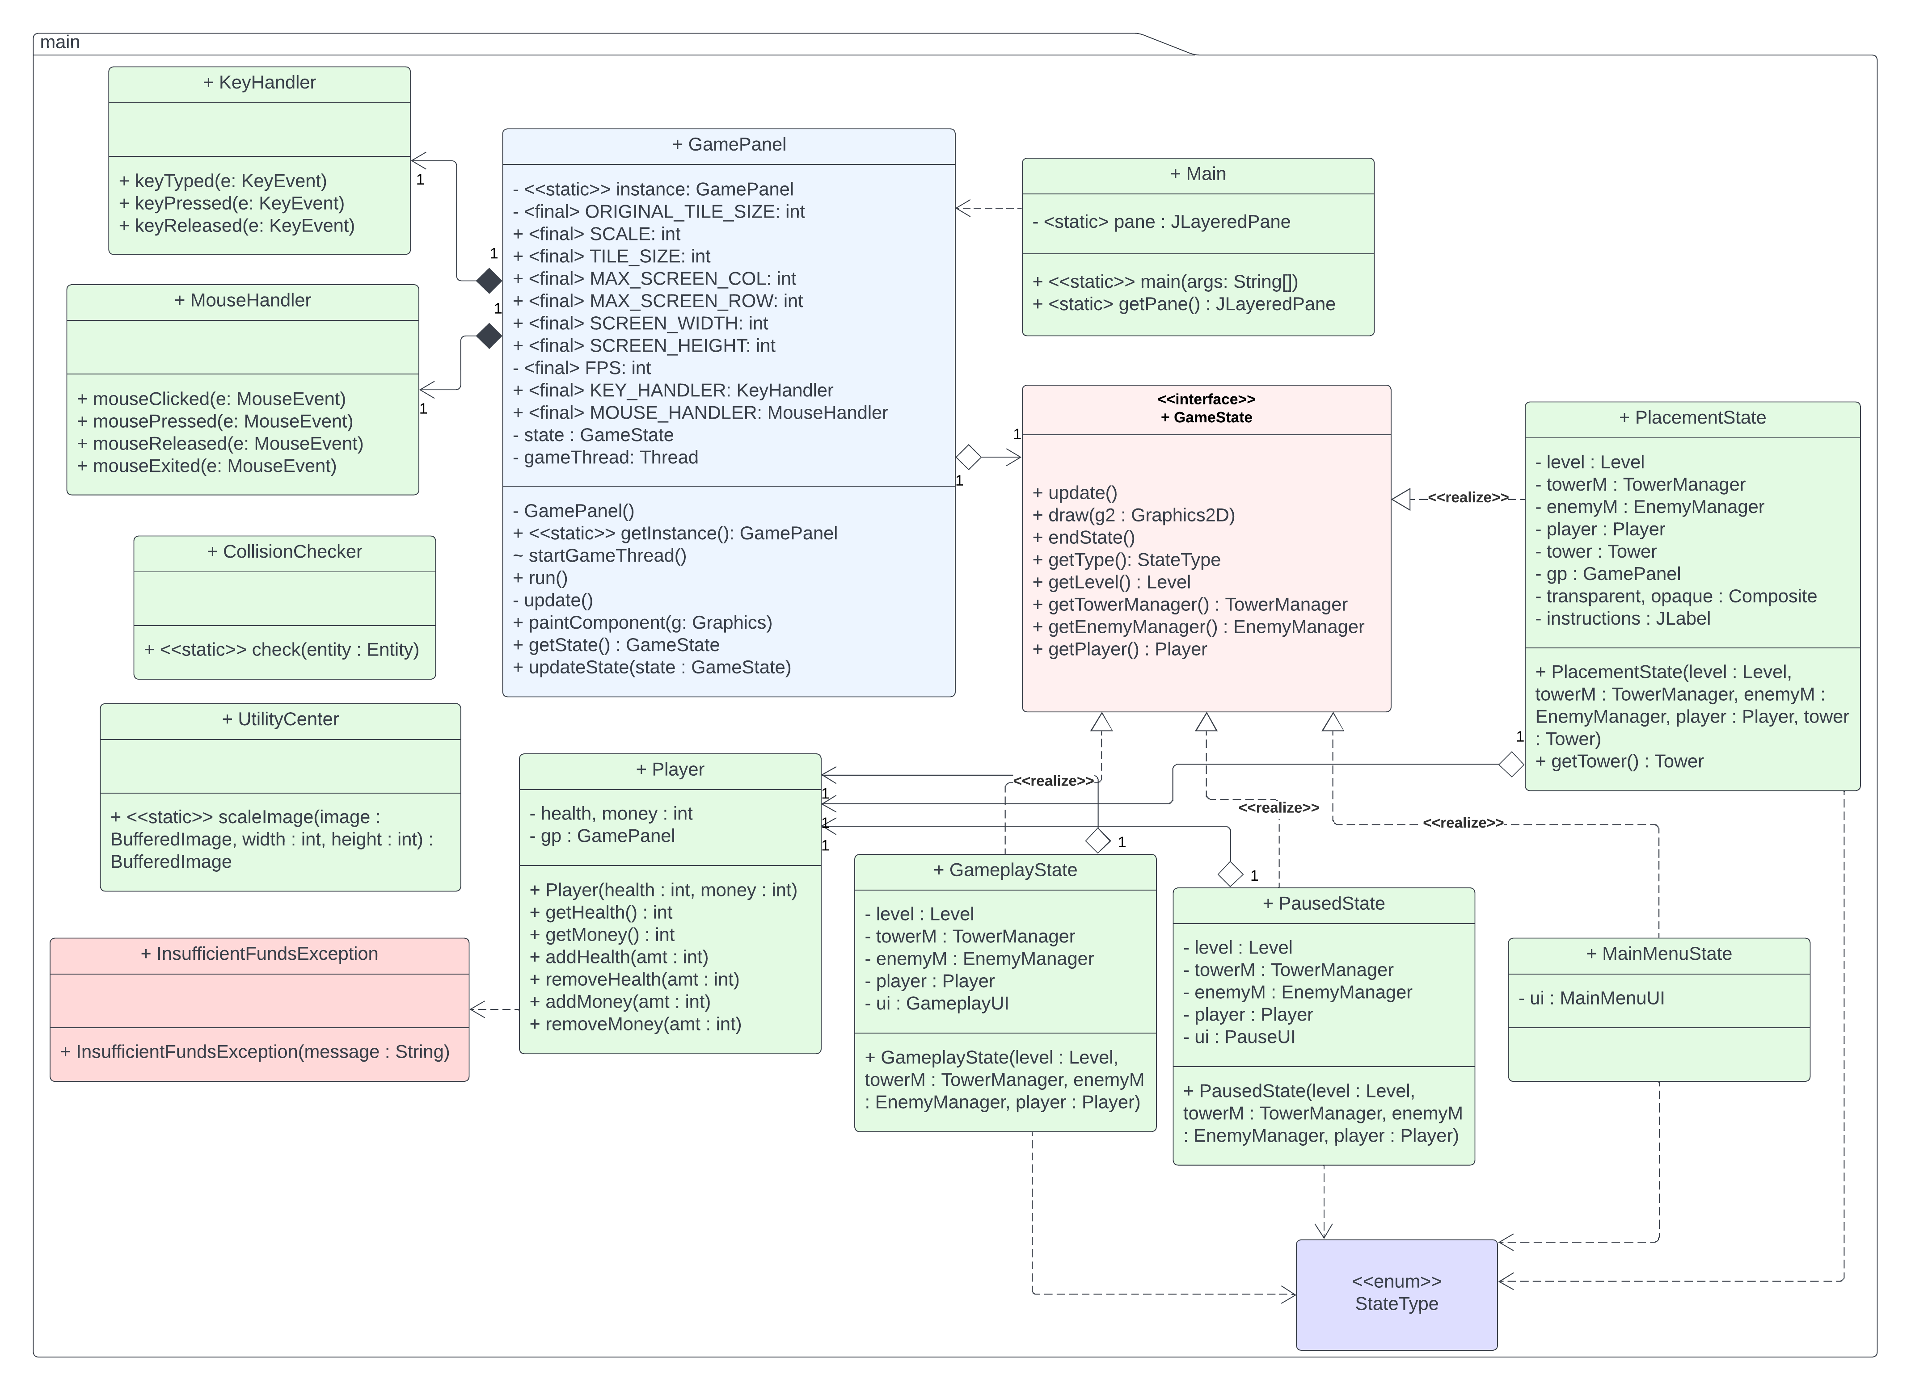
Main Package UML Diagram

Slide 8
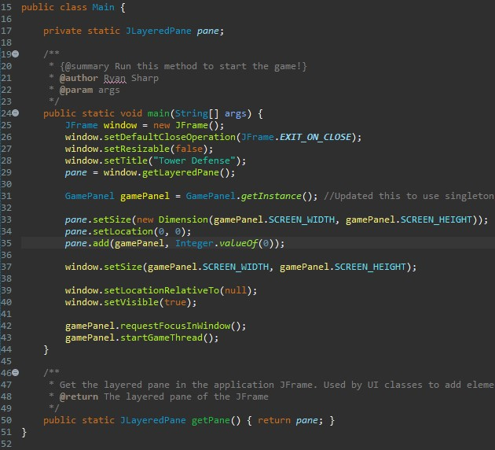
Main.java
Sets up the JFrame window
Initializes the GamePanel singleton
Places the GamePanel on the bottom layer of the content pane
Starts the game thread which allows game to run
getPane() method allows external classes to add and remove content from pane

Slide 9
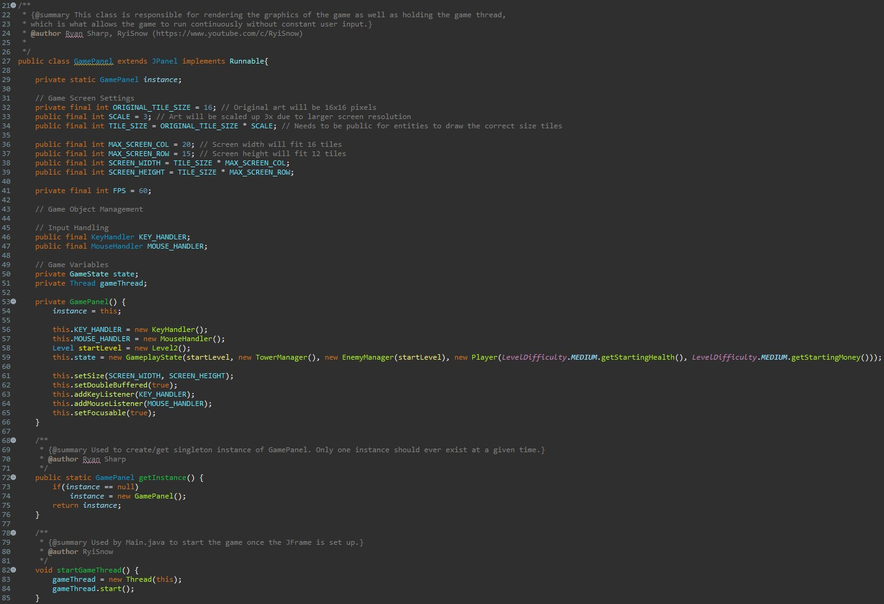
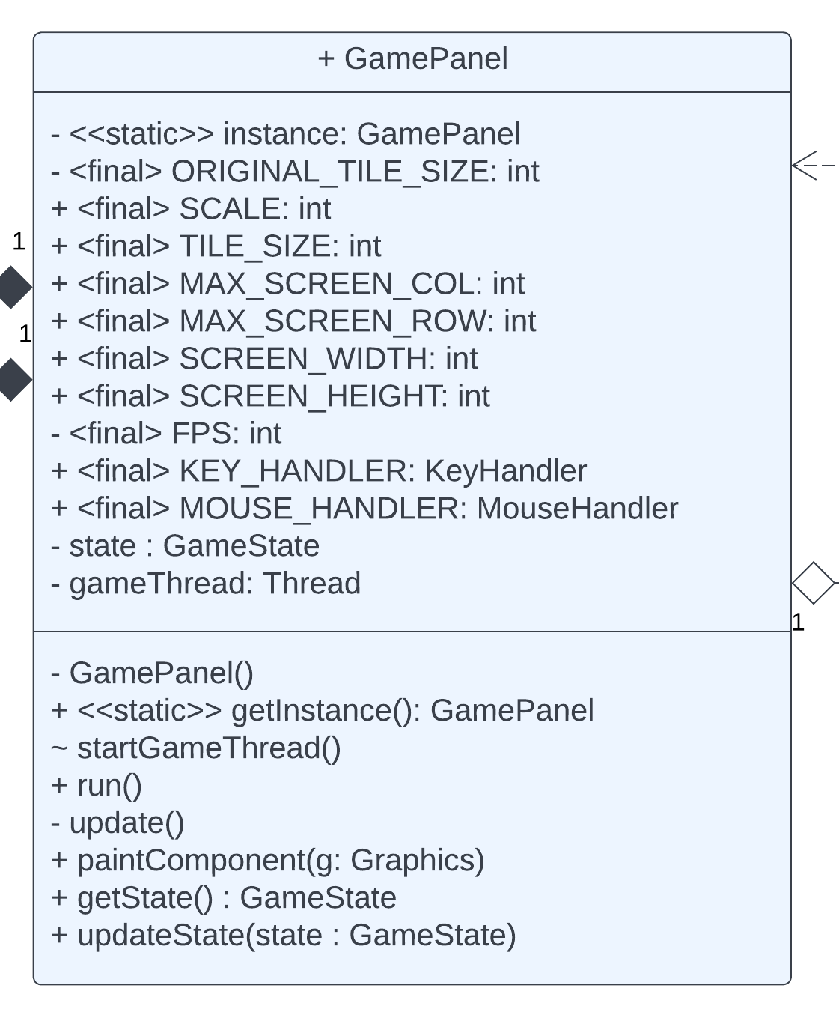
GamePanel.java Singleton Pattern

Slide 10
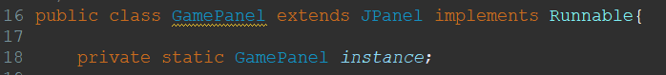
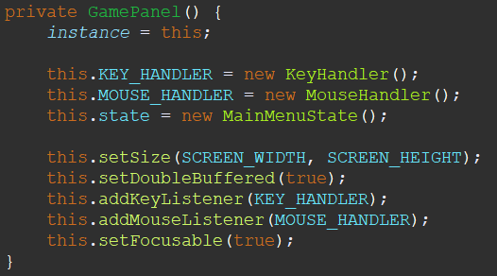
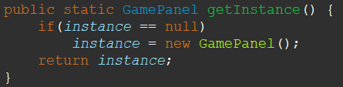
GamePanel.java Singleton Pattern

Slide 11
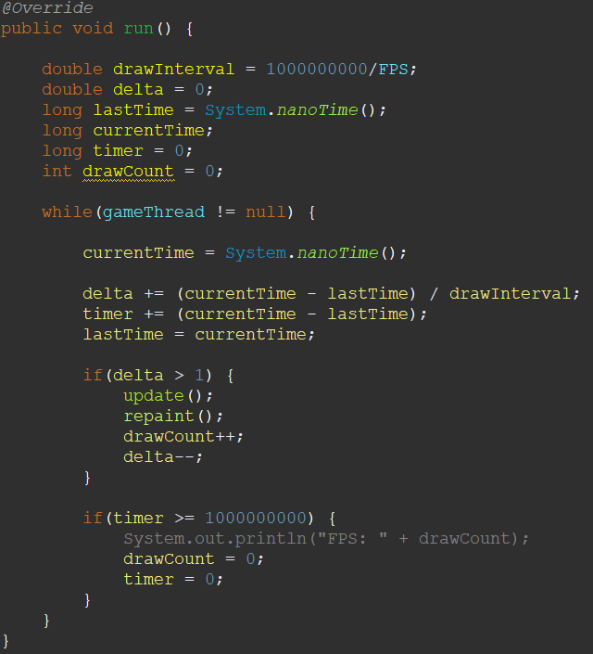
Game Loop
Set FPS using variable
Calculate time passed between loops
After enough time...
Update components
Redraw components
Reset timer

Slide 12
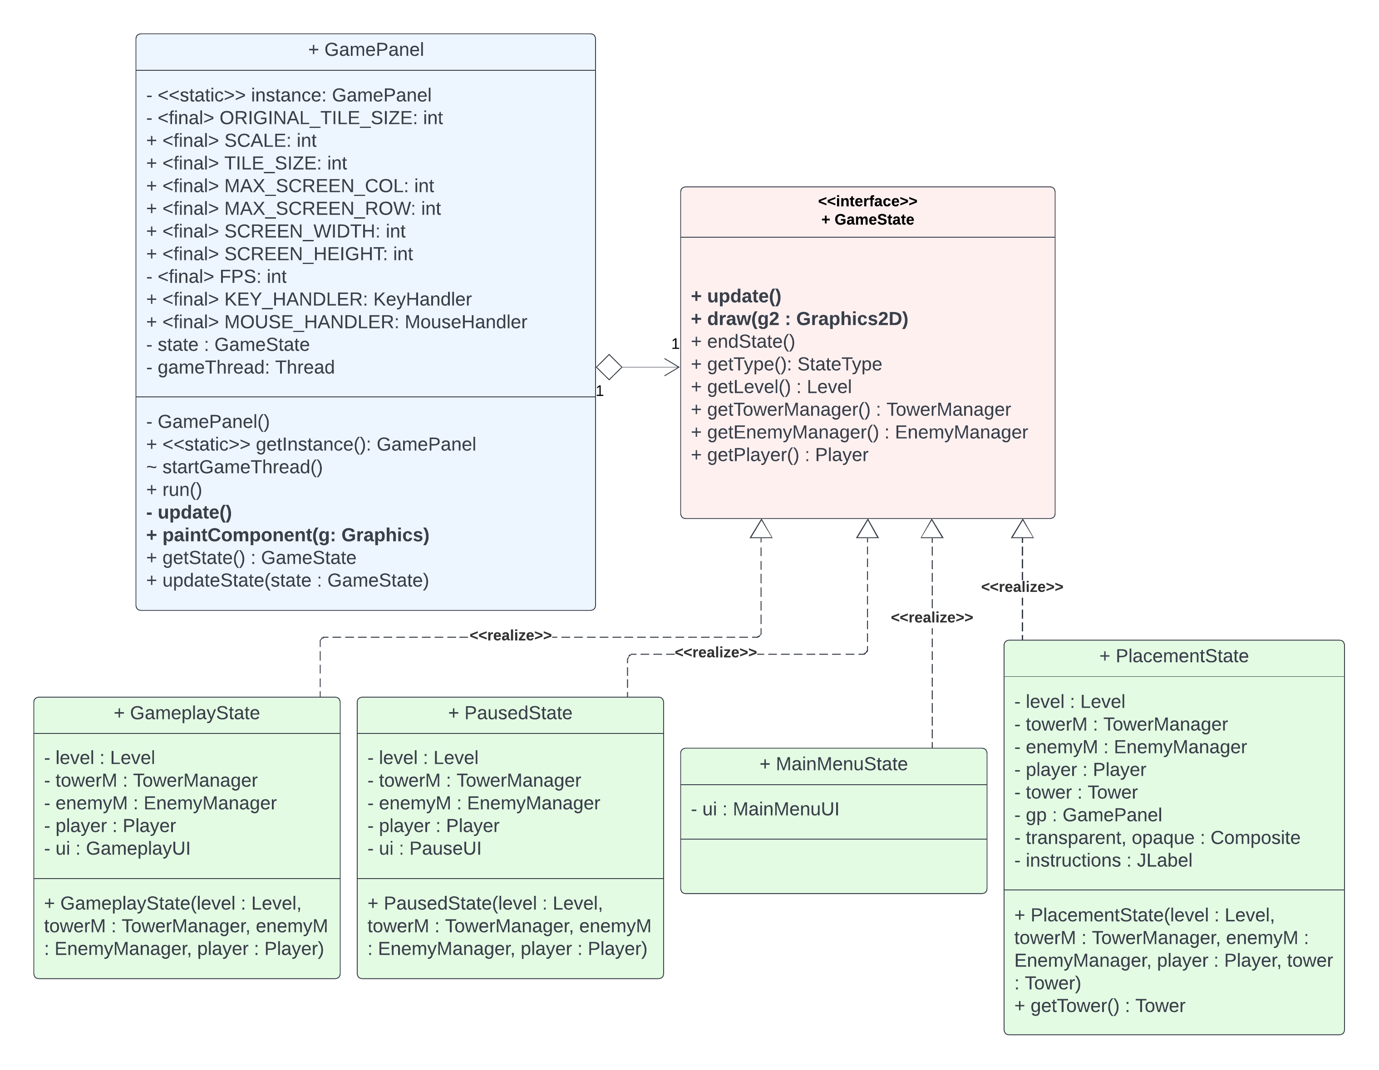
Game States Strategy Pattern
Update and repaint change between states
Not enough control to be state pattern

Slide 13
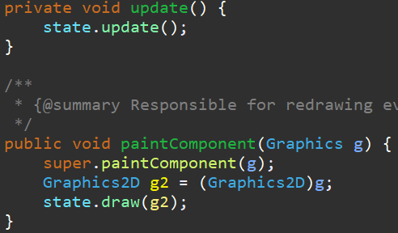
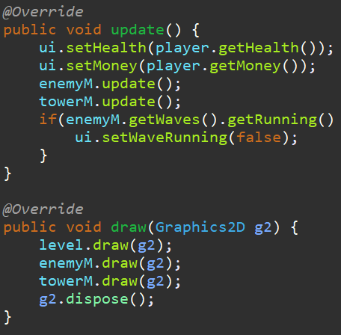
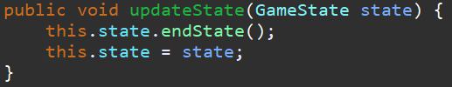
Game States Code Example

Slide 14
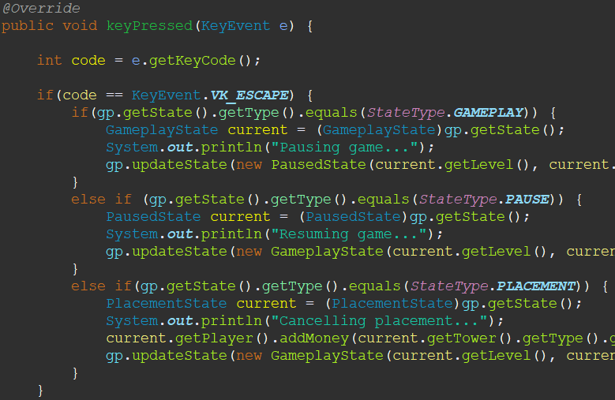
Changing States Input Handling

Slide 15
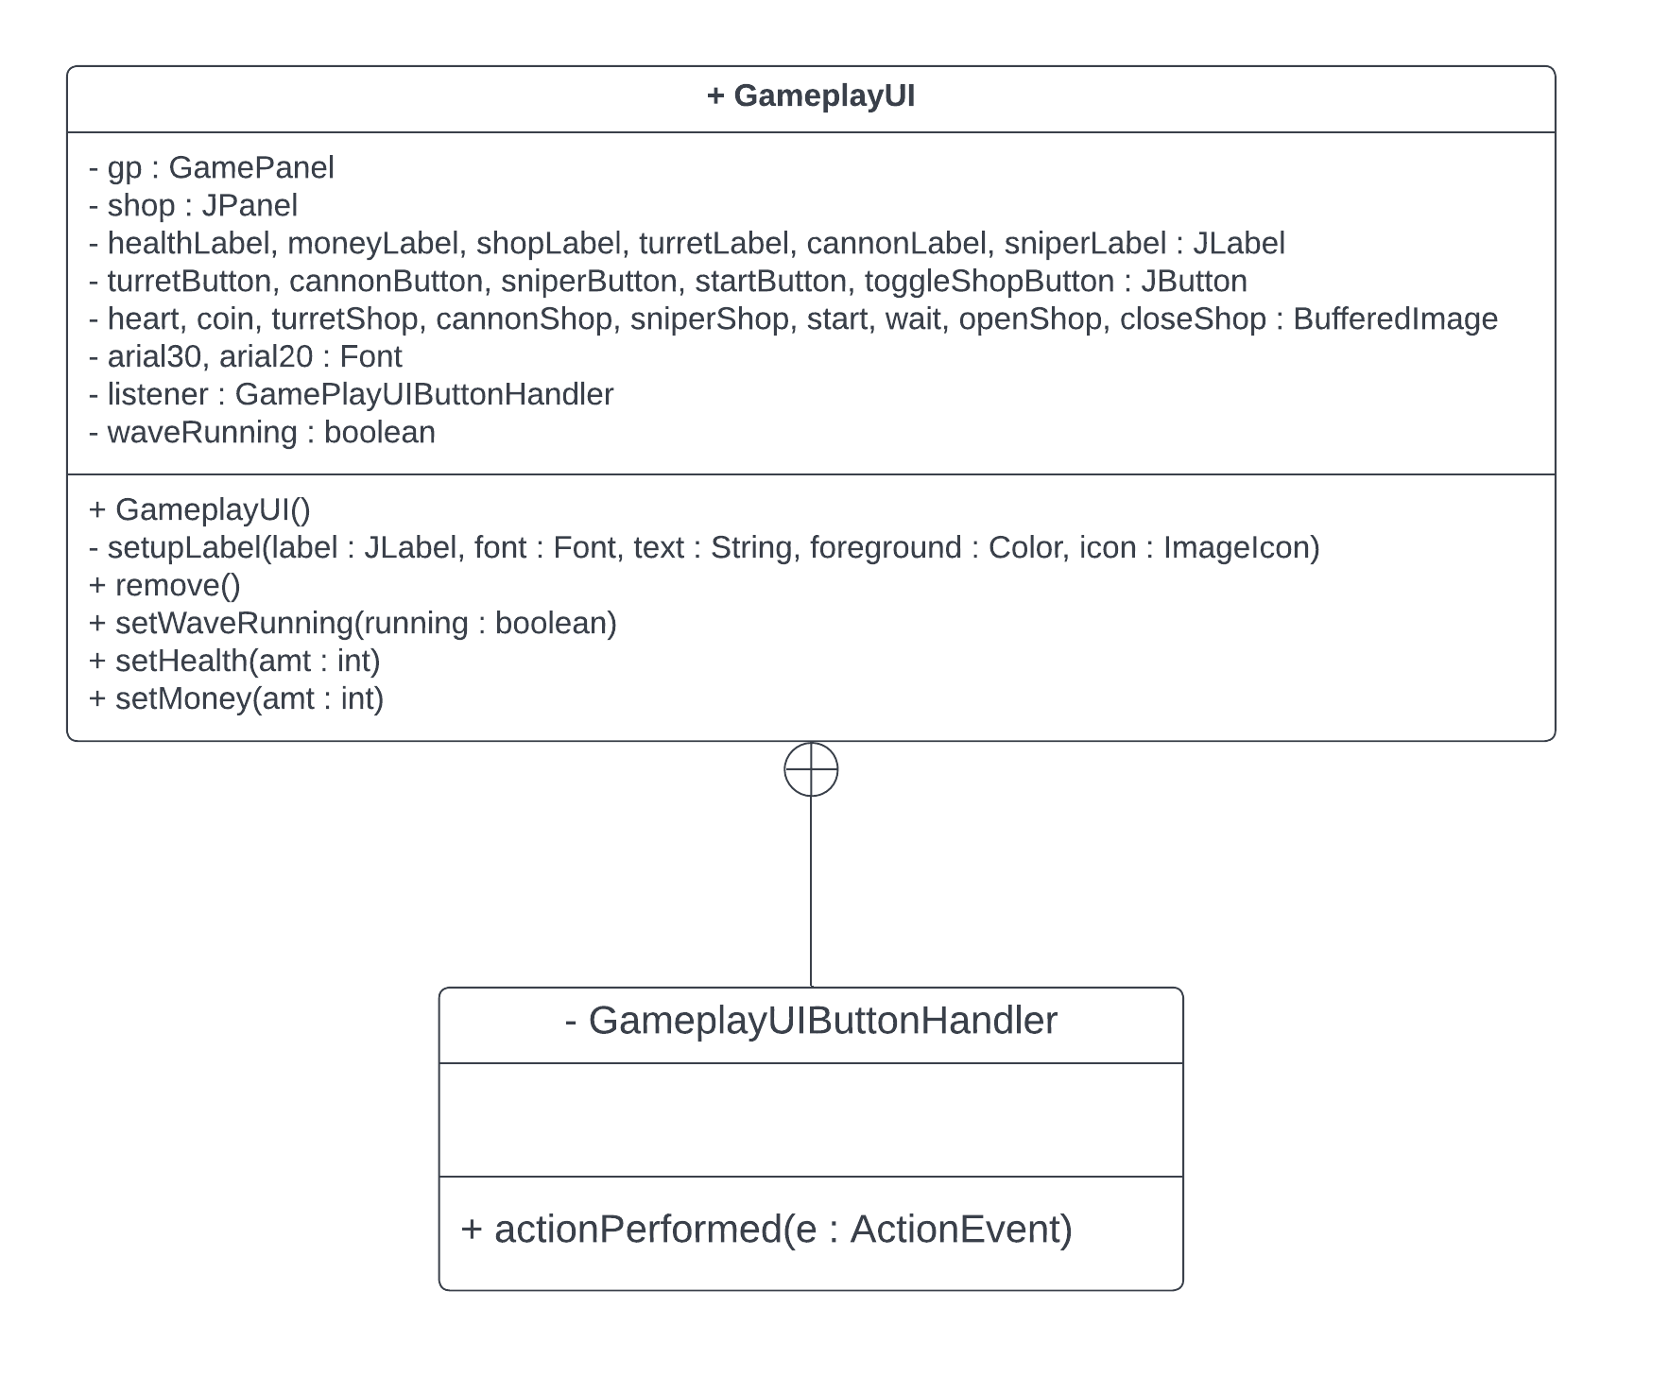
User Interface Nested Classes

Slide 16
Levels Package
Creates levels
Populates an array of MapTile types – “TileSet”
Populates an array that defines the map
Loads the correct tiles using the two arrays
Patterns:
Template
Abstract Factory

Slide 17
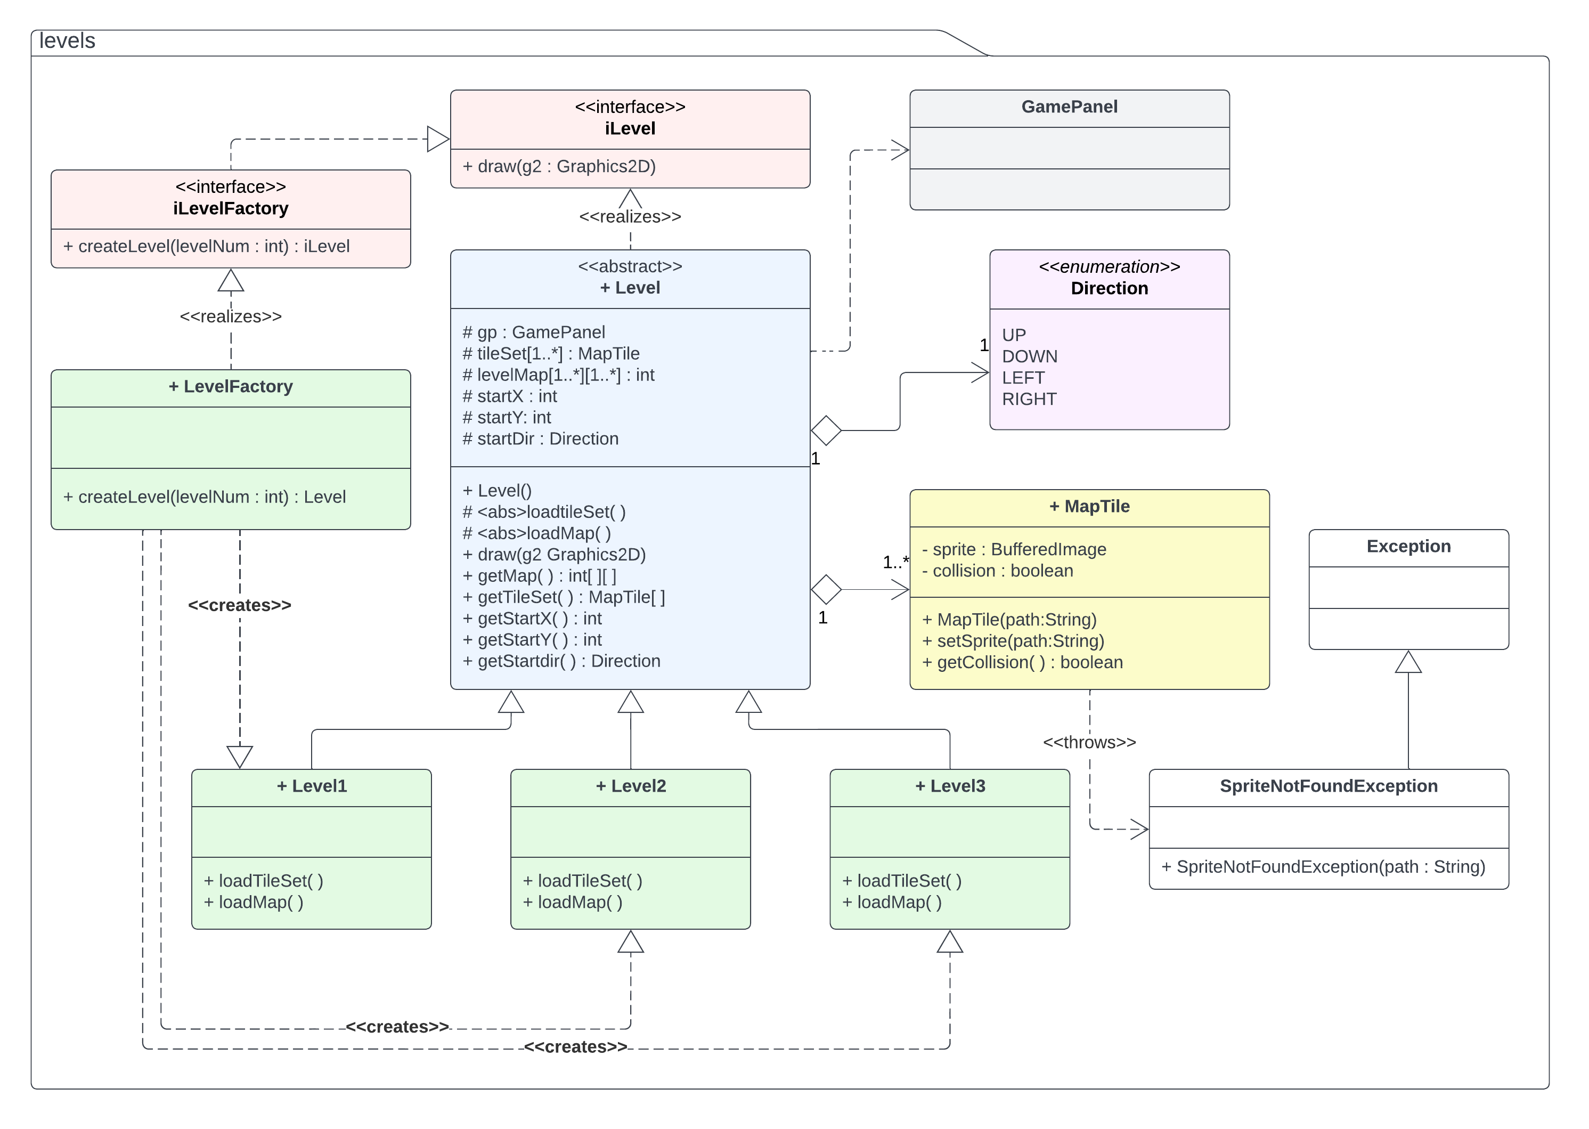
Levels UML Diagram

Slide 18
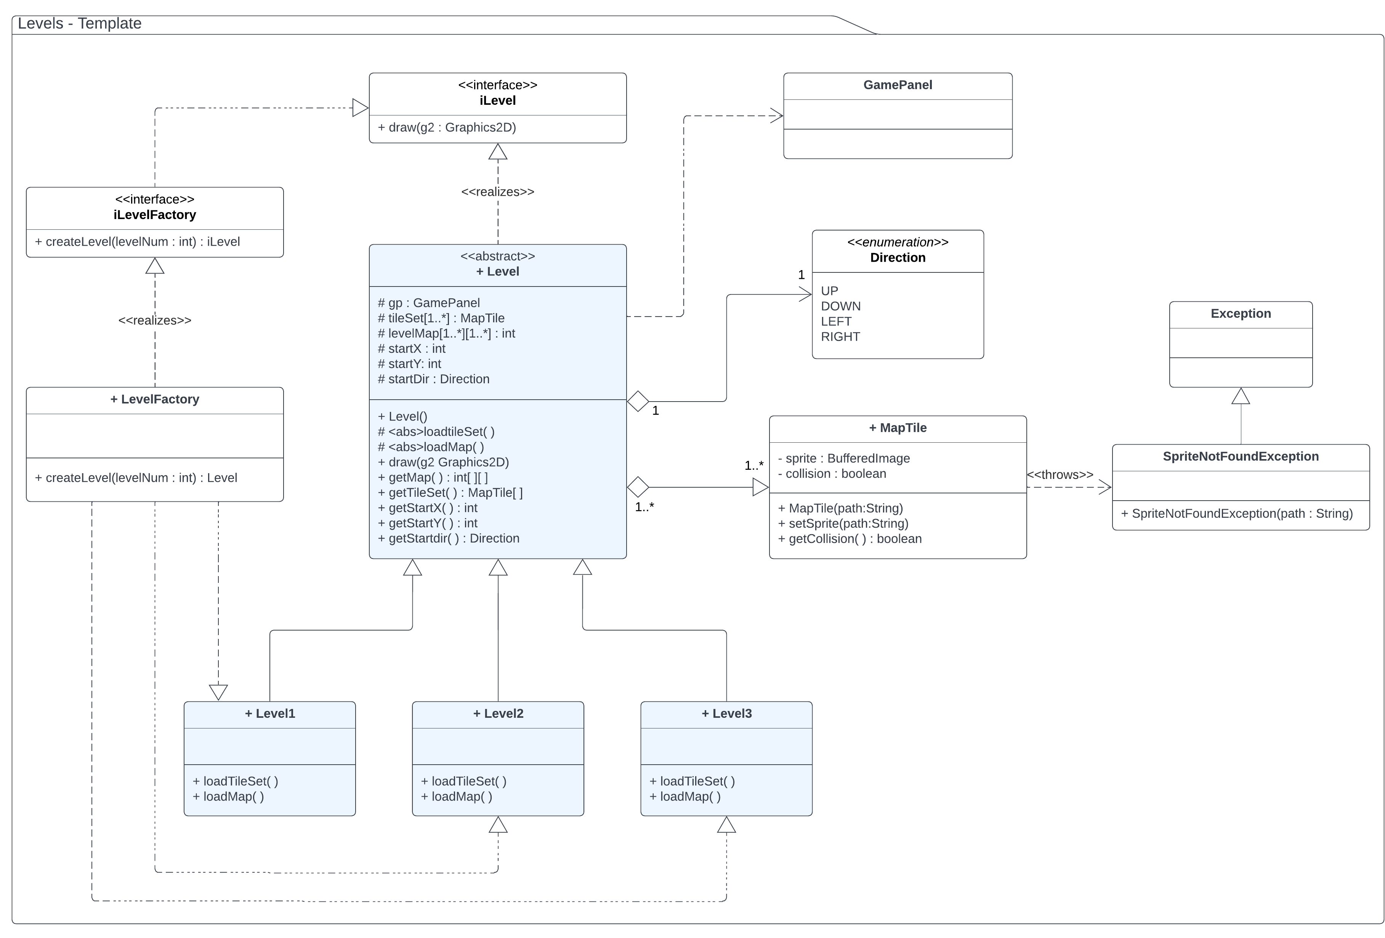
Levels Template

Slide 19
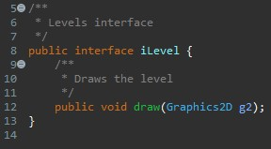
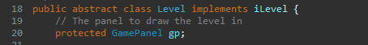
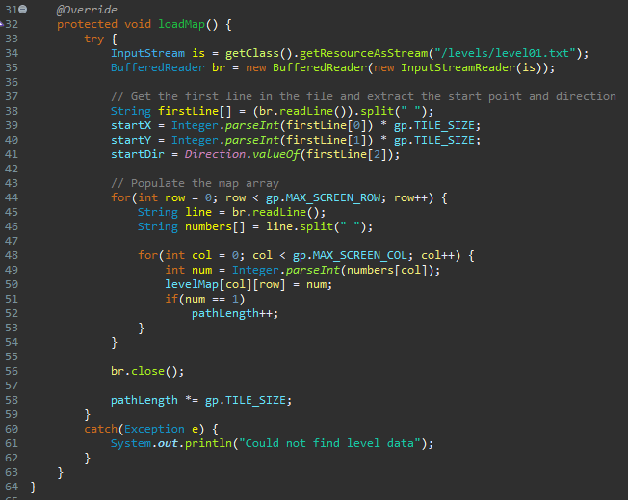
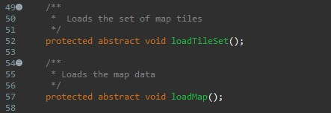
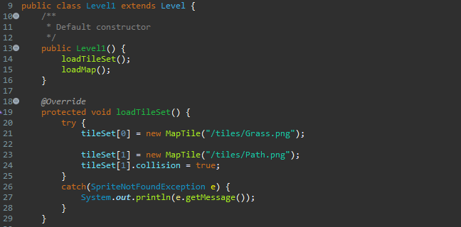
Levels Template

Slide 20
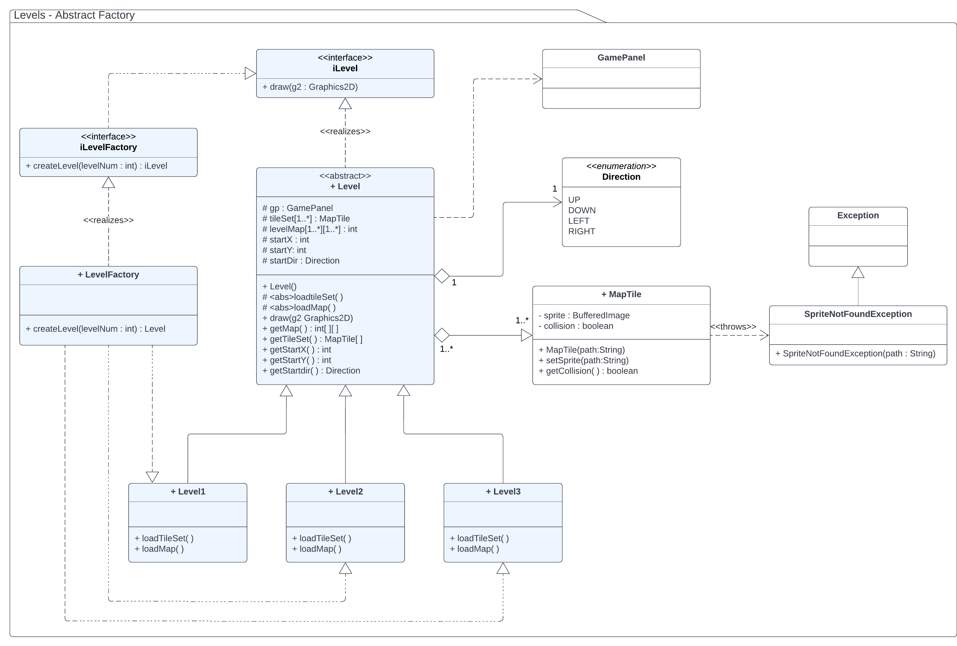
Levels Abstract Factory

Slide 21
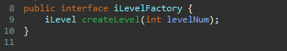
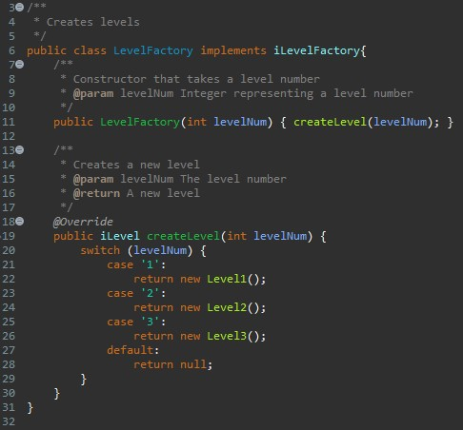
Levels Abstract Factory

Slide 22
Entities
Enemies
Towers

Slide 23
Entities Enemies
Creates enemies:
Enemies travel the path to reach the end
Enemies that make it to the end cause the player to lose health
Patterns:
Prototype
Abstract Factory
Decorator
Composite

Slide 24
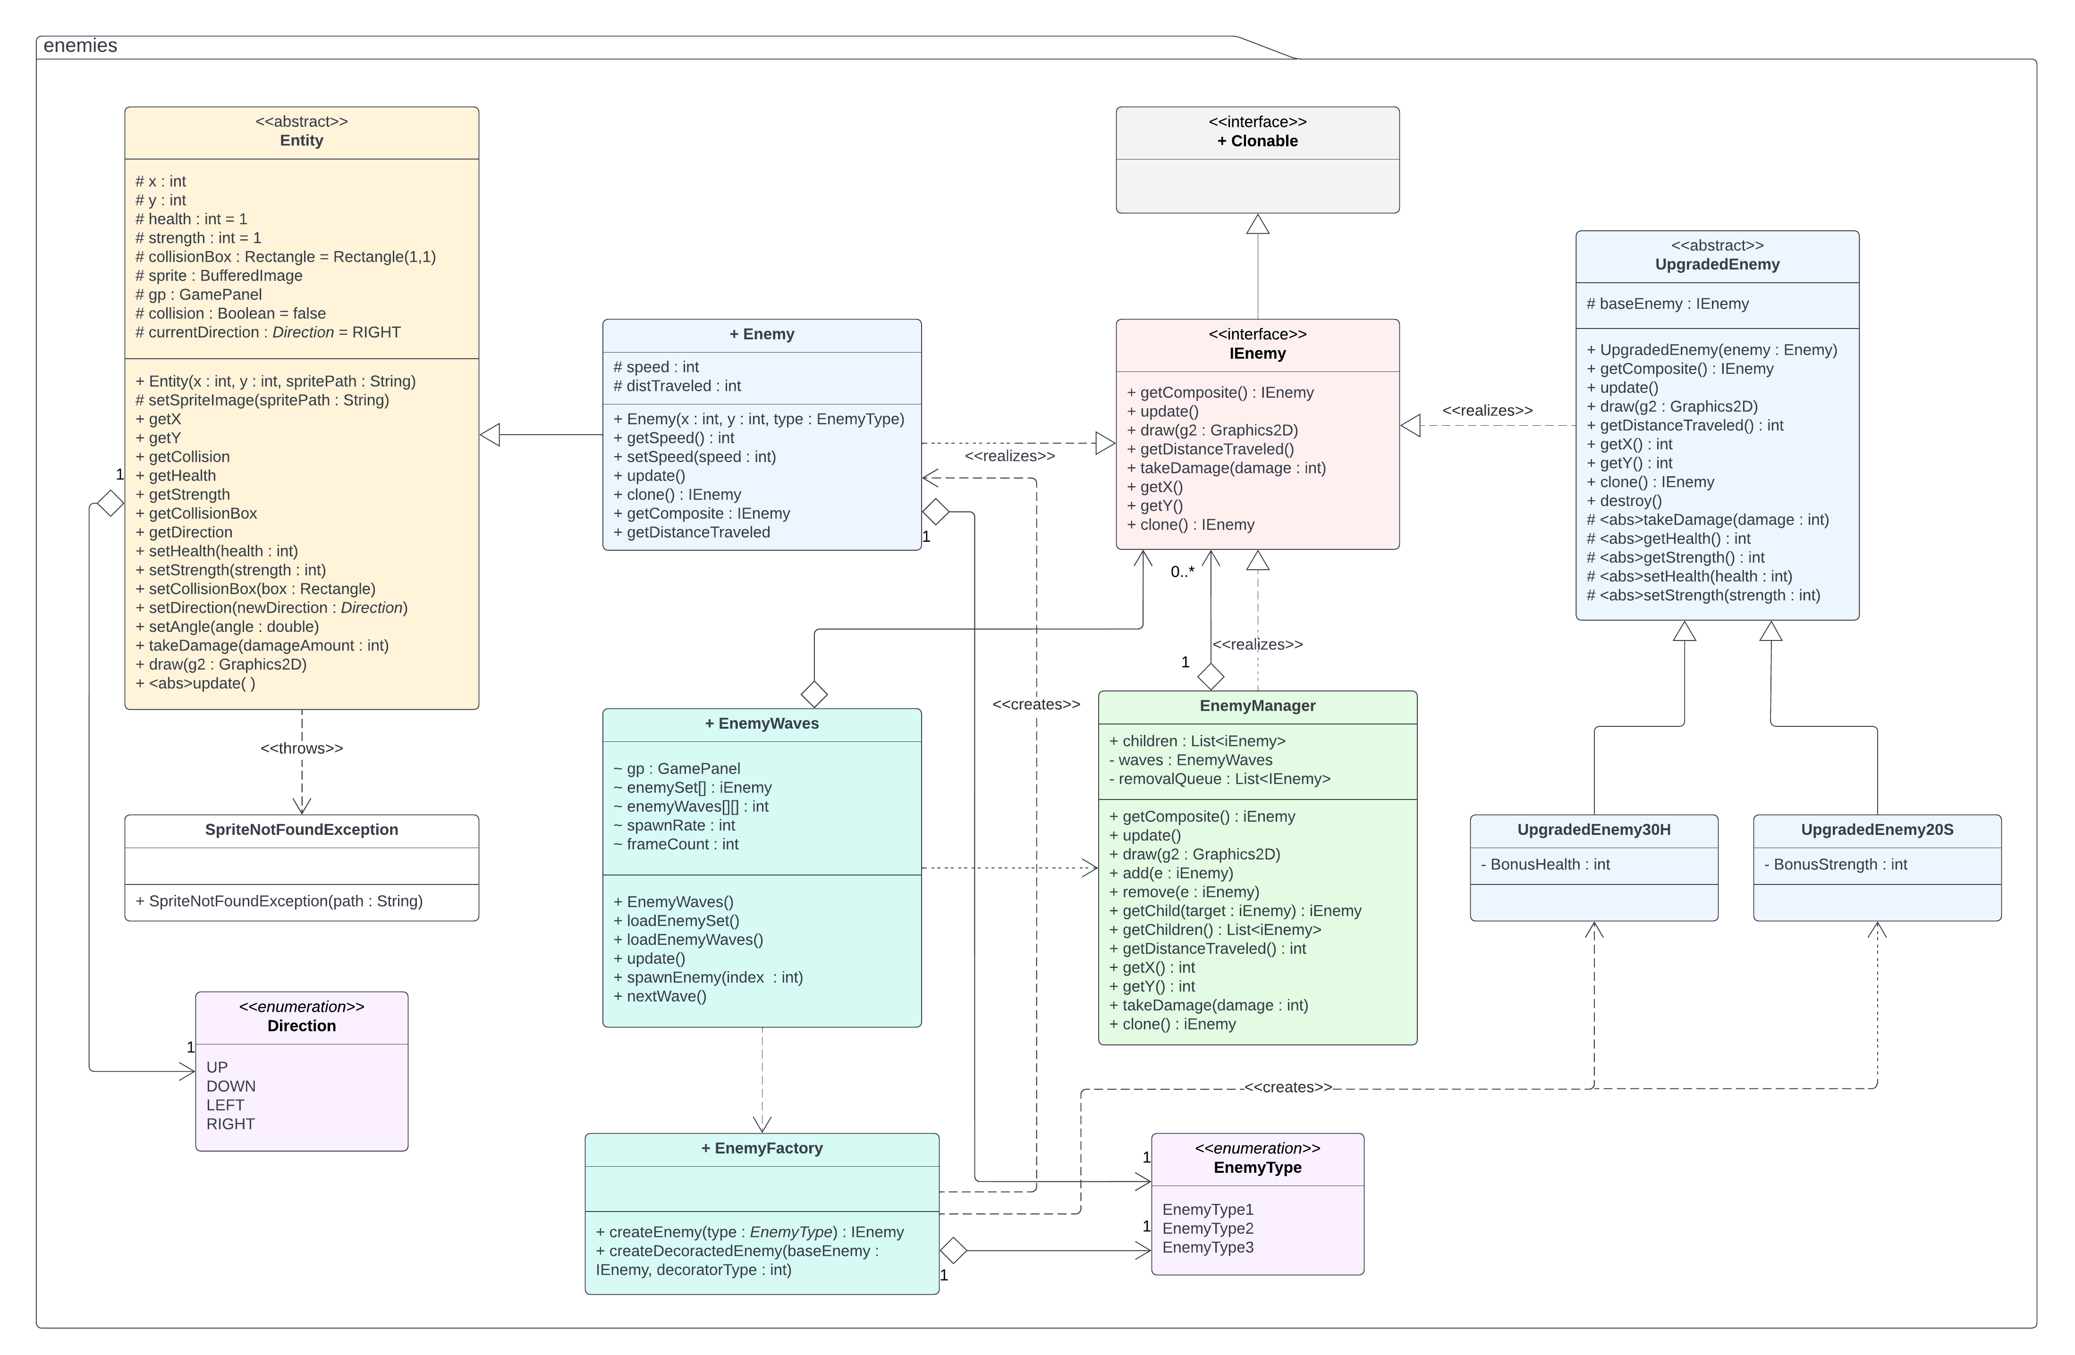
Enemies UML Diagram

Slide 25
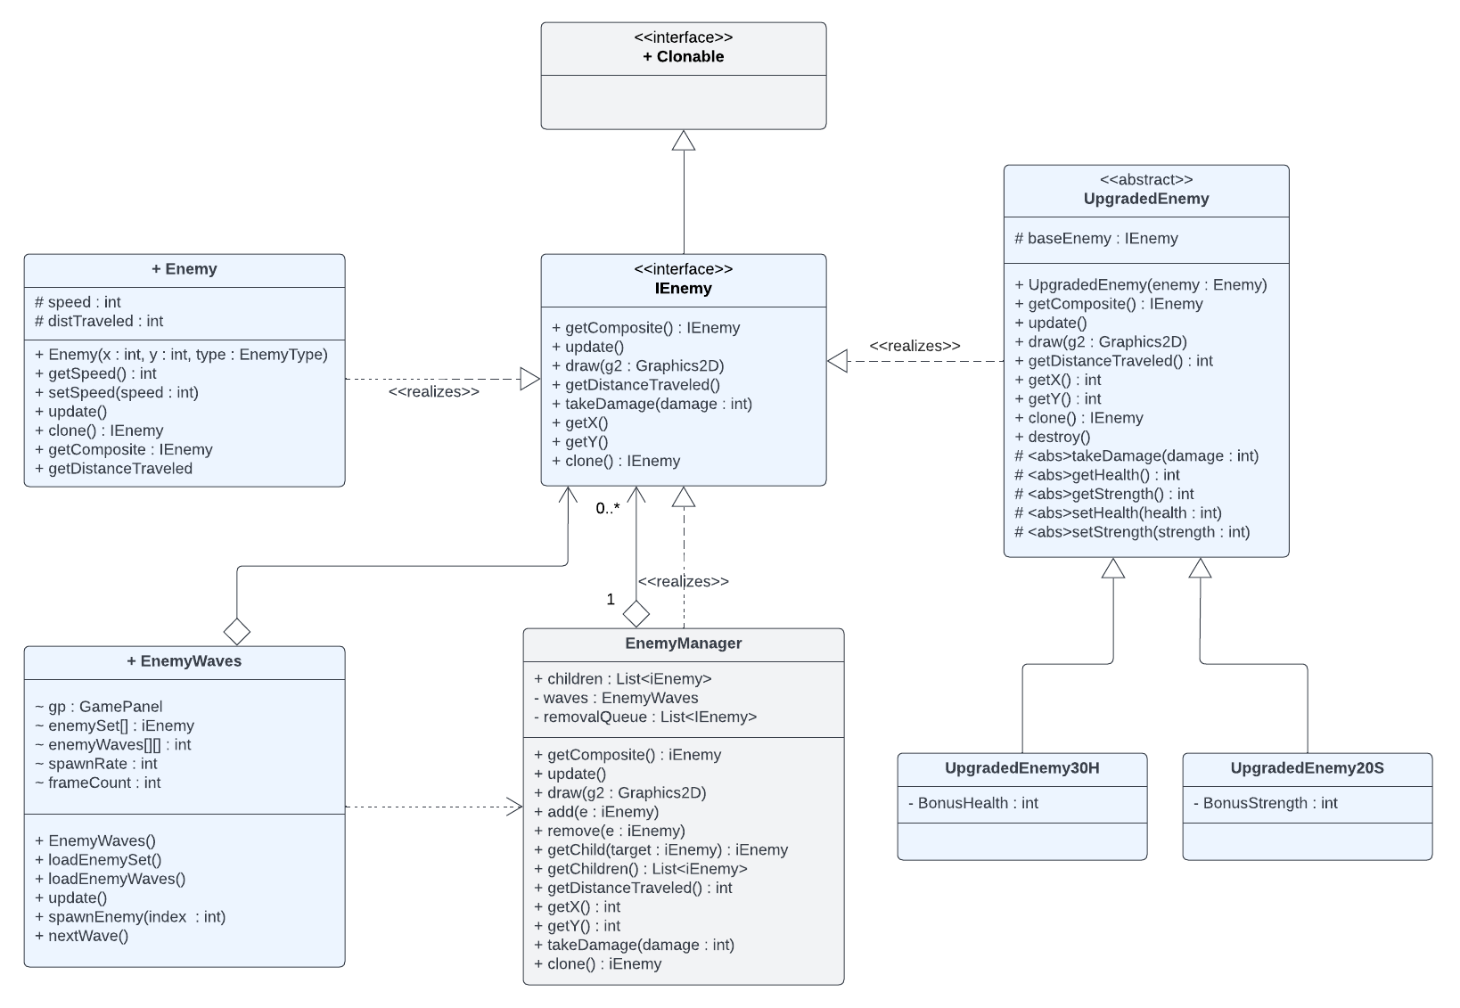
Enemies Prototype

Slide 26
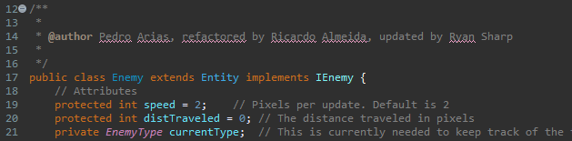
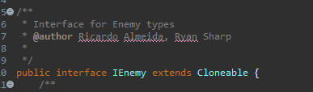
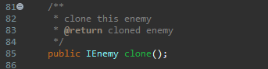
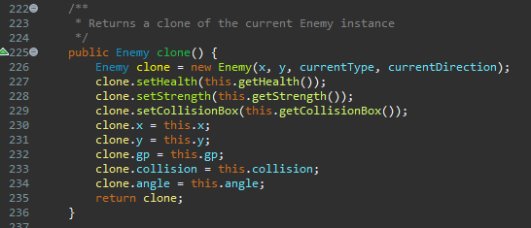
Enemies Prototype

Slide 27
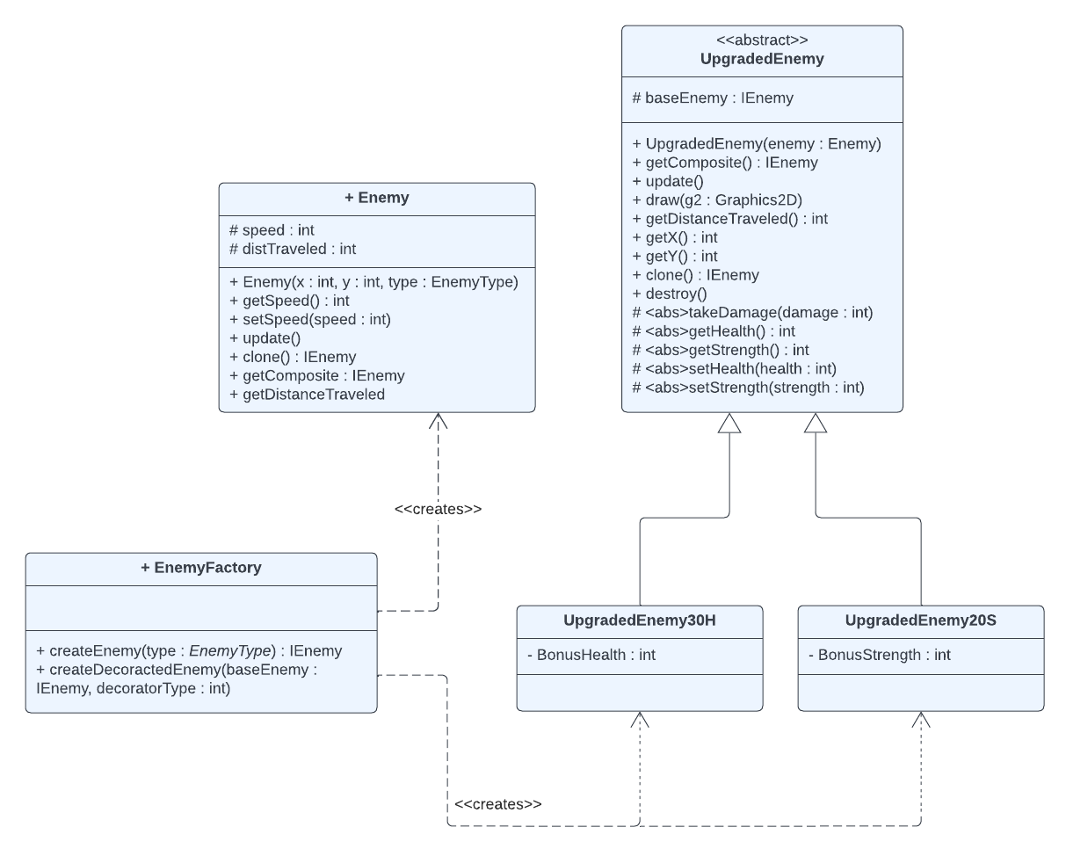
Enemies Abstract Factory

Slide 28
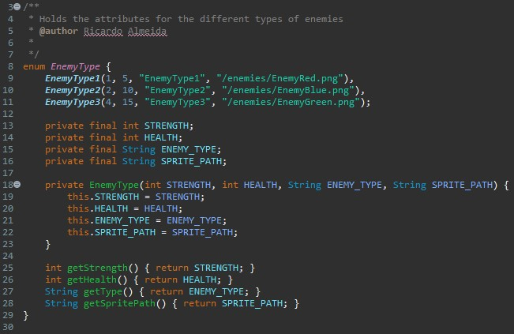
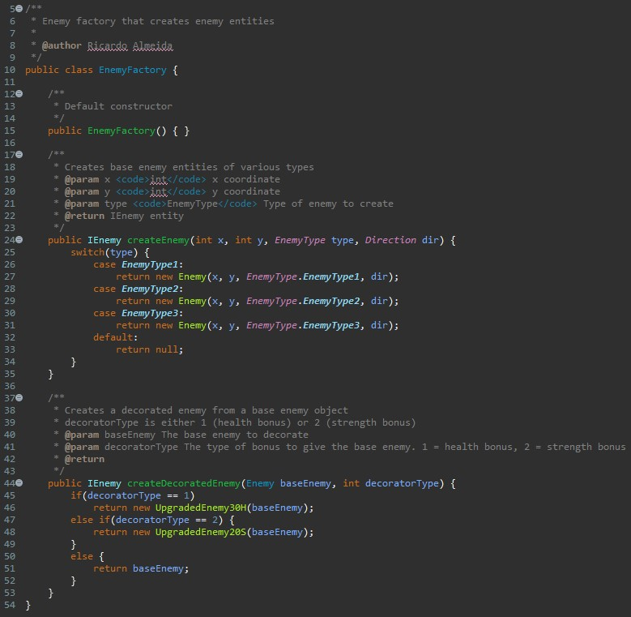
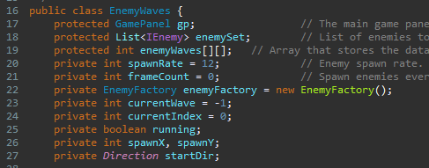
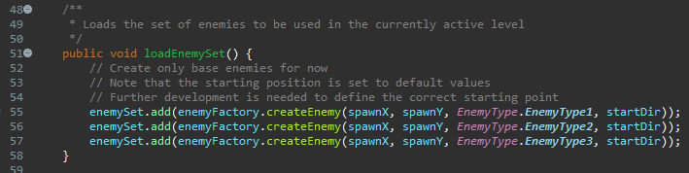
Enemies Abstract Factory

Slide 29
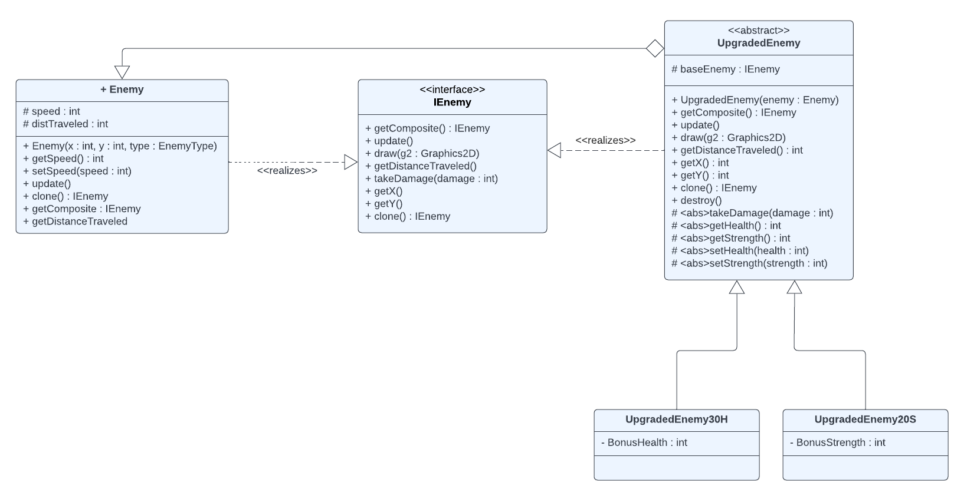
Enemies Decorator

Slide 30
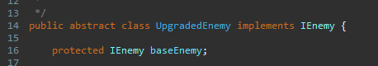
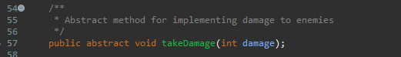
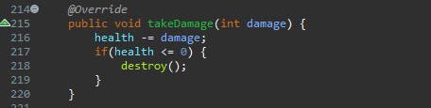
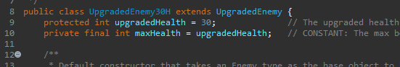
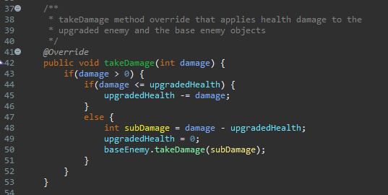
Enemies Decorator

Slide 31
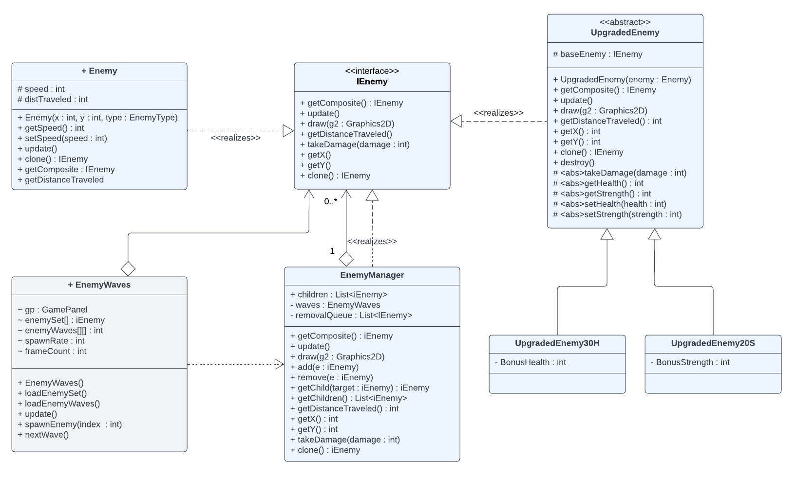
Enemies Composite

Slide 32
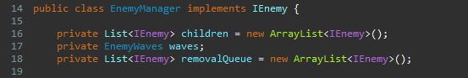
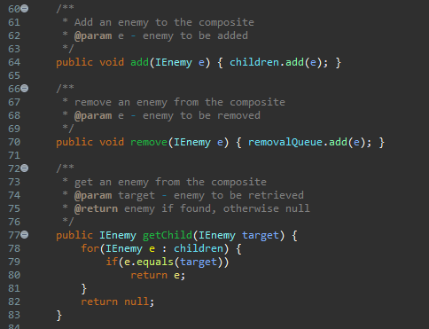
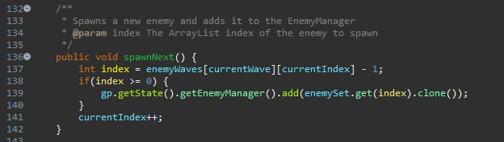
Enemies Composite

Slide 33
Towers
Patterns
Template
Composite
Decorator
Enum

Slide 34
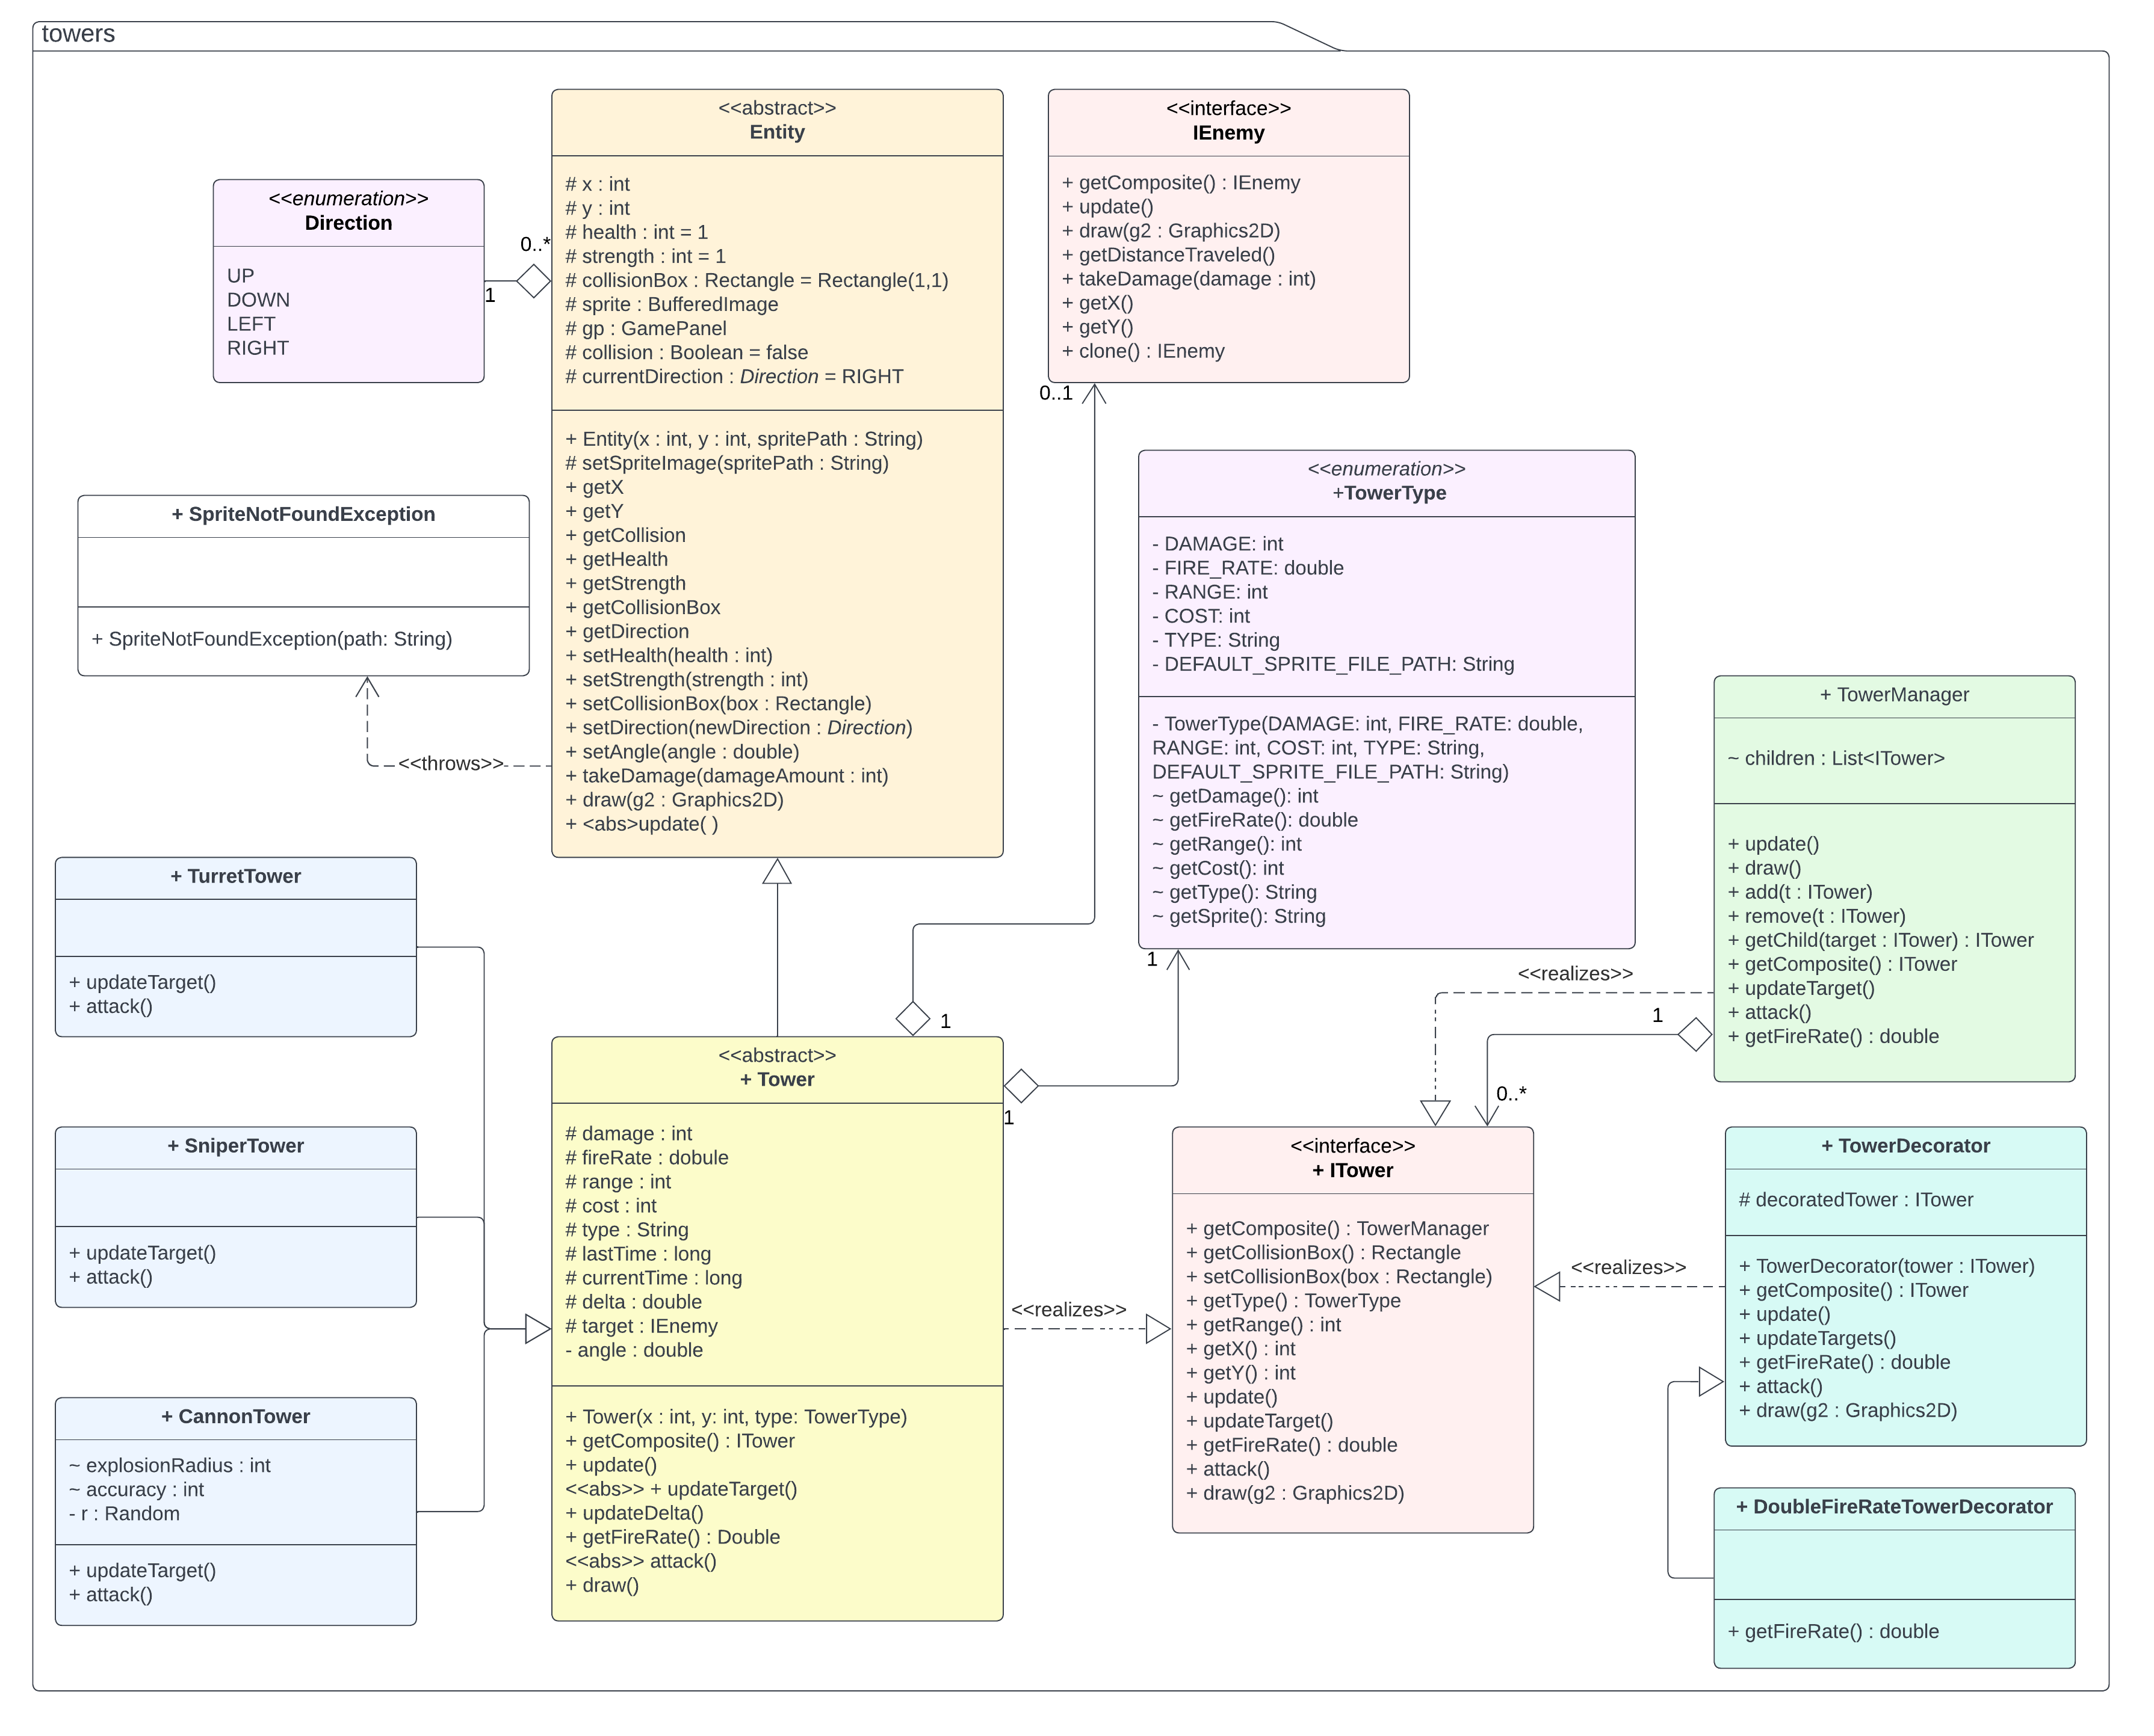
Towers UML Diagram

Slide 35
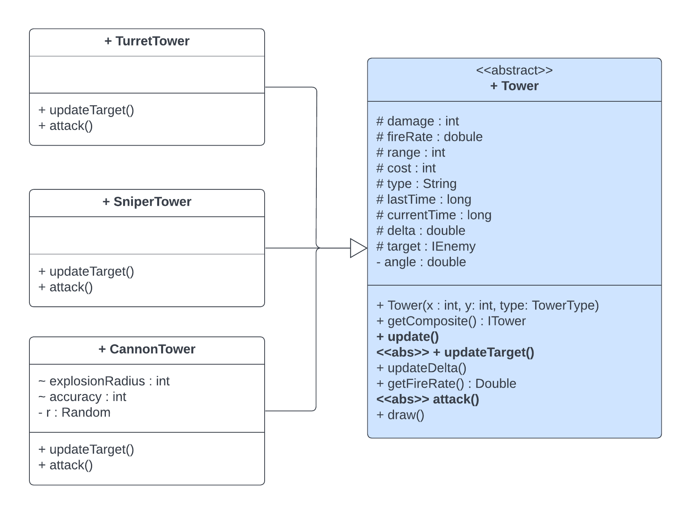
Towers Template Pattern

Slide 36
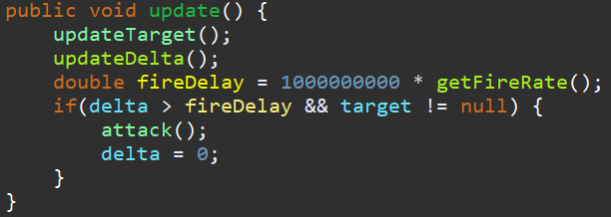

Towers Template Pattern

Slide 37

Towers Composite & Decorator Patterns

Slide 38



Towers Composite & Decorator Patterns

Slide 39

Towers Enumeration

Slide 40
Demo

